Slide 1
FACULTY OF ENGINEERING
CAIRO UNIVERSITY
LAB 3 INTRODUCTION TO VHDL
CMP301A: COMPUTER ARCHITECTURE COURSE
EXERTED FROM DR. ADNAN SHAOUT- THE UNIVERSITY OF MICHIGAN-DEARBORN
Notes:
‹#›

Slide 2
OBJECTIVES
Behavioral Modeling
Review about Conditional statements.
Combinational logic vs. registered logic processes.
Variables, Signals, Constants.

Slide 3
REVIEW
Code written maps to Hardware
General Code written in VHDL is Concurrent
Only inside a Process the code is sequential
Every entity could have one Architecture or More
Architecture can be modeled as dataflow, Structural or Mixed or ,… let’s see Next

Slide 4
MUX … THE BEHAVIORAL WAY
ENTITY mux IS
PORT( a,b,c,d : IN std_logic;
s : IN std_logic_vector(1 DOWNTO 0);
x : OUT std_logic);
END mux;

Slide 5
MUX … THE BEHAVIORAL WAY
ARCHITECTURE behav OF mux IS BEGIN
PROCESS (s0,s1,a,b,c,d)
BEGIN IF s0 = '0' AND s1 = '0' THEN y <= a ;
ELSIF s0 = '0' AND s1 = '1' THEN
y <= b; ELSIF s0 = '1' AND s1 = '0' THEN
y <= c;
ELSE
y <= d ; END IF; END PROCESS;
END behav;
Architecture course
sensitivity list
Sequential statements
Executes one by one because process is a special case
Intro to VHDL
*
Notes:
we will explain process later

Slide 6
IF … ELSE / CASE … WHEN
ARCHITECTURE a_mux_seq OF mux_seq
BEGIN
PROCESS(a,b,c,d,s)
BEGIN
IF(s = "00") THEN
x <= a ;
ELSIF (s = "01") THEN
x <= b;
ELSIF (s = "10") THEN
x <= c;
ELSE
x <= d;
END IF;
END PROCESS;
END a_mux_seq;
ARCHITECTURE b_mux_seq OF mux_seq
BEGIN
PROCESS(a,b,c,d,s)
BEGIN
CASE s IS
WHEN "00” =>
x <= d ;
WHEN "01” =>
x <= c;
WHEN "10” =>
x <= b;
WHEN OTHERS =>
x <= a;
END CASE;
END PROCESS;
END b_mux_seq;

Slide 7
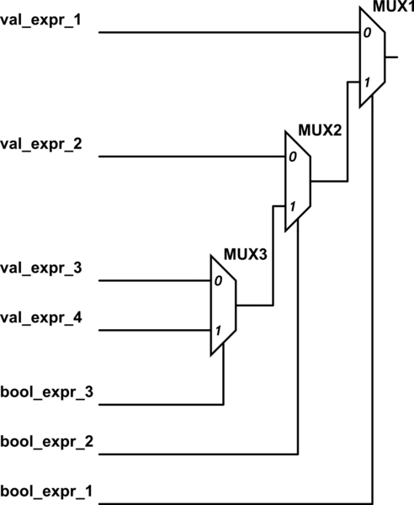
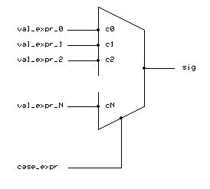
IF … ELSE / CASE … WHEN

Slide 8
IMPORTANT NOTES ABOUT PROCESSES
Process is concurrent with respect to each other.
Process is concurrent with other concurrent statements.
Processes are only triggered on the change of the parameters in its sensitivity list
Process with no sensitivity list loops forever ( except … to be mentioned later)
To generate Combinational circuit using processes, All ports/signals on the right-hand side or in the conditions should be in the sensitivity list.

Slide 9
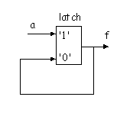
IF … ELSE / CASE … WHEN
(IF ... ELSE) & (CASE … WHEN) statements are used only inside a process
Outside process we use (WHEN … ELSE) or (WITH … SELECT)
Look for (WITH … SELECT) syntax in VHDL, Its similar to …..?
What happens if we missed a case ?!
A latch will be formed to save previous value
Notes:
Ensure the students Know the difference between Latches and Flipflob
case a is
when ‘1’ | ‘0’ => d <= ‘1’;
when ‘Z’ => d <= ‘0’;
when others => d <= ‘X’; -- optional
end case;
-----
WITH sel
SELECT output <= in0 WHEN "00",
in1 WHEN "01", in2 WHEN "10",
in3 WHEN "11", 'X'
WHEN OTHERS;

Slide 10
REVIEW CONDITIONAL STATEMENTS…1
ARCHITECTURE a_mux_seq OF mux IS
BEGIN
PROCESS(a,b,c,d,s)
BEGIN
IF (s = "00") THEN
x <= a;
ELSIF (s = "01") THEN
x<=b;
ELSIF(s = “10”) THEN
x<=c;
ELSE x<=d;
END IF;
END PROCESS;
END a_mux_seq;
ARCHITECTURE a_mux_con OF mux IS
BEGIN
x <= a WHEN s = “00”
ELSE b WHEN s= “01”
ELSE c WHEN s = “10”
ELSE d;
END a_mux_con ;

Slide 11
REVIEW CONDITIONAL STATEMENTS…2
ARCHITECTURE b_mux_seq OF mux IS
BEGIN
PROCESS(a,b,c,d,s)
BEGIN
CASE s IS
WHEN "00" =>
x <= a;
WHEN "01" =>
x<= b;
WHEN "10" =>
x<=c;
WHEN OTHERS =>
x<=d ;
END CASE;
END PROCESS;
END b_mux_seq;
ARCHITECTURE b_mux_con OF mux IS
BEGIN
WITH s SELECT
x <= a WHEN "00", b WHEN "01",
c WHEN "10",
d WHEN OTHERS;
END b_mux_con ;
Note: it is a comma not semi colon

Slide 12
REVIEW CONDITIONAL STATEMENTS…3
If no “else” or “default” block exist , it automatically generates a latch to reserve the value .

Slide 13
WHAT IS A REGISTER ?!

Slide 14
REGISTERED LOGIC…EXAMPLE _1
LIBRARY IEEE;
USE IEEE.std_logic_1164.all;
ENTITY my_DFF IS
PORT( d,clk,rst : IN std_logic; q : OUT std_logic);
END my_DFF;
ARCHITECTURE a_my_DFF OF my_DFF IS
BEGIN
PROCESS(clk,rst)
BEGIN
IF(rst = '1') THEN
q <= '0';
ELSIF clk'event and clk = '1' THEN
q <= d;
END IF;
END PROCESS;
END a_my_DFF;

Slide 15
REGISTERED LOGIC…EXAMPLE _1
LIBRARY IEEE;
USE IEEE.std_logic_1164.all;
ENTITY my_DFF IS
PORT( d,clk,rst : IN std_logic; q : OUT std_logic);
END my_DFF;
ARCHITECTURE a_my_DFF OF my_DFF IS
BEGIN
PROCESS(clk,rst)
BEGIN
IF(rst = '1') THEN
q <= '0';
ELSIF rising_edge(clk) THEN
q <= d;
END IF;
END PROCESS;
END a_my_DFF;
Last if doesn’t have an “else” part so it will be automatically generate the behavior as “else q <=q;”

Slide 16
REGISTERED LOGIC…EXAMPLE _2
Remember the generic data
ENTITY my_nDFF IS
GENERIC ( n : integer := 16);
PORT( Clk,Rst : IN std_logic;
d : IN std_logic_vector(n-1 DOWNTO 0);
q : OUT std_logic_vector(n-1 DOWNTO 0));
END my_nDFF;

Slide 17
REGISTERED LOGIC…EXAMPLE _2
ARCHITECTURE a_my_nDFF OF my_nDFF IS
BEGIN
PROCESS (Clk,Rst)
BEGIN
IF Rst = '1' THEN
q <= (OTHERS=>'0');
ELSIF rising_edge(Clk) THEN
q <= d;
END IF;
END PROCESS;
END a_my_nDFF;
ARCHITECTURE b_my_nDFF OF
my_nDFF IS
COMPONENT my_DFF IS
PORT( d,Clk,Rst : IN std_logic; q : OUT std_logic);
END COMPONENT;
BEGIN
loop1: FOR i IN 0 TO n-1 GENERATE
fx: my_DFF PORT MAP(d(i),Clk,Rst,q(i));
END GENERATE;
END b_my_nDFF;
Notice the use of others when size is unknown or too big to write
Remember the for..generate

Slide 18
VARIABLE, SIGNAL, CONSTANT

Slide 19

CONSTANT DECLARATION
A constant can have a single value of a given type.
A constant’s value cannot be changed during the simulation.
Constants declared at the start of an architecture can be used anywhere in the architecture.
Constants declared in a process can only be used inside the specific process.
CONSTANT constant_name : type_name : = value;
CONSTANT rise_fall_time : TIME : = 2 ns;
CONSTANT data_bus : INTEGER : = 16;

Slide 20
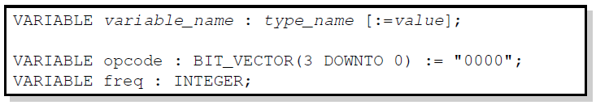
VARIABLE DECLARATION
Variables are used for local storage of data.
Variables are generally not available to multiple components or processes.
All variable assignments take place immediately.
Variables are more convenient than signals for the storage of (temporary) data.

Slide 21
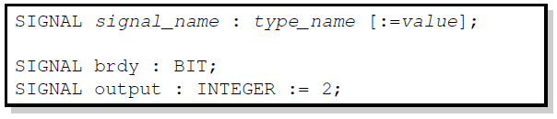
SIGNAL DECLARATION
Signals are used for communication between components.
Signals are declared outside the process.
Signals can be seen as real, physical signals.
Some delay must be incurred in a signal assignment.

Slide 22
SIGNAL VS VARIABLE
CAN BE USED ANYWHERE
X <= Y
CHANGES CAN’T BE SEEN UNLESS AFTER A DELAY
ONLY USED INSIDE A PROCESS X : = Y CHANGES CAN BE SEEN IMMEDIATELY
SIGNAL s : bit :=‘0’;
…. PROCESS(x)
BEGIN
s < = ‘1’;
a <= s;
END PROCESS;
PROCESS(x)
VARIABLE s : bit :=‘0’;
BEGIN
s : = ‘1’;
a <= s;
END PROCESS;
a = ‘0’
a = ‘1’

Slide 23
SIGNAL VS VARIABLE
 | Signals | Variables
Assignment Operator | <= e.g. Sig1 <= a and b; The left side must be signal | := e.g. Var1 := a and b; The left side must be variable
Use | Represents circuit interconnect | Represents local storage
Deceleration Region | Signals may only be declared in the declarative part of an Architecture (i.e. before BEGIN) | Variables may only be declared in the declarative part of the process (i.e. before the BEGIN).
Scope | Global Signals, seen by all the concurrent statements. | Local to process
Behavior | Updated at end of process execution(new value not immediately available) | Updated immediately

Slide 24
BEFORE REQUIREMENTS
If a signal or a port got to be open circuit we put on it ‘Z’ high impedance
Port mode (direction ) has three modes :
From outside we see it as :
In ← input port can be used to feed data to this entity only
Out ← output port can be used to get data from this entity only
Inout ← can be used in both cases
From inside we see it as :
In ← input port can be used to get data from outside only (can’t write to)
Out ← output port can be used to show output only (can’t read from)
Inout ← can be used in both cases

